Slide 1

ANDROID
TECHNOLOGY

Slide 2
INTRODUCTION
WHAT IS ANDROID?
A Software platform and operating
system for mobile.
Based on the Linux kernel.
Android was found way back in 2003.
It was developed in Palo Alto, California.
Android was developed by the Andy Rubin, Rich Miner, Nick Sears and Chris White.
Android was purchased by the GOOGLE in AUGUST,2005 for 50 million $.

Slide 3
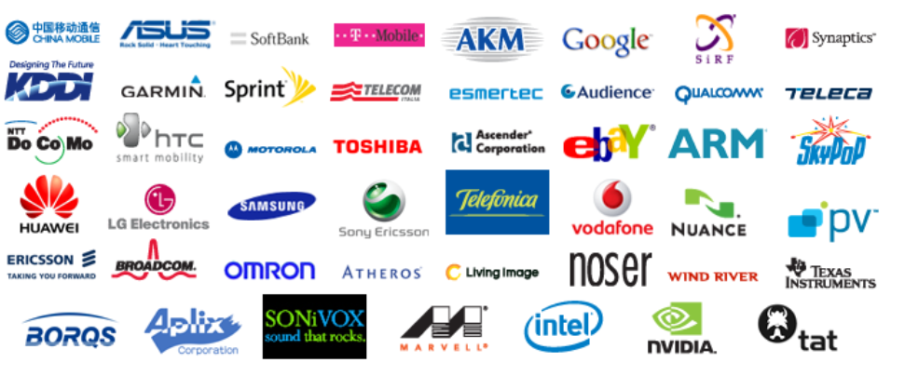
Open handset alliance(oha)
What is OHA?
It’s consortium of several companies.
This group of companies are allowed to use source code of Android and develop applications.
Reason for Nokia not to develop Android Mobiles is Nokia is not part of OHA.

Slide 4
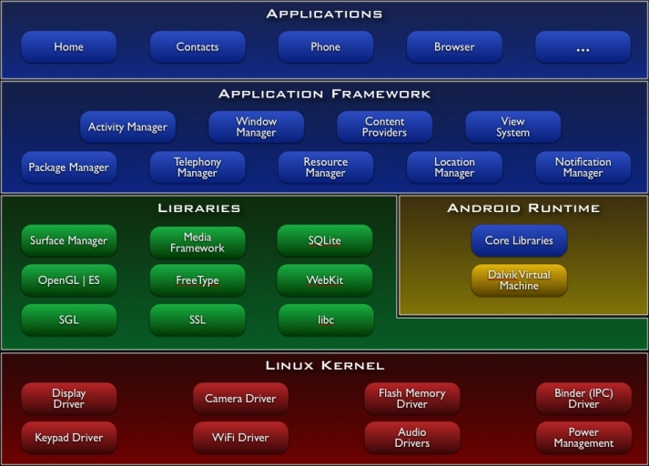
Android Architecture:-

Slide 5
FEATURES OF ANDROID
Android is not a single piece of hardware.
Android supports wireless communication using:-
3G Networks
4G Networks
802.11 Wi-Fi Networks
Bluetooth Connectivity
Android is a multi-process system, in which each application (and parts of the system) runs in its own process.

Slide 6
FEATURES OF ANDROID
Interface that is better then the previous touch screen mobiles.
User gets millions of applications that user can not get in any other mobile operating system.
Android supports advanced audio/video/still media formats such as MPEG-4, H.264, MP3, and AAC, AMR, JPEG, PNG, GIF.
Developing an android application is not tough using SDK(standard development kit) and java emulator we can easily develop applications that we want.

Slide 7
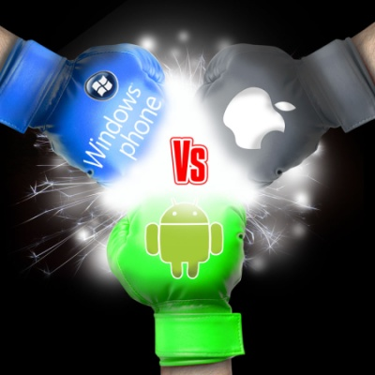
COMPARISON WITH OTHER
OPERATING SYSTEMS
Other then Android there are several other
mobile operating system which is used.
Symbian, iOS, windows this are one of the
most used mobile operating systems.

Slide 8
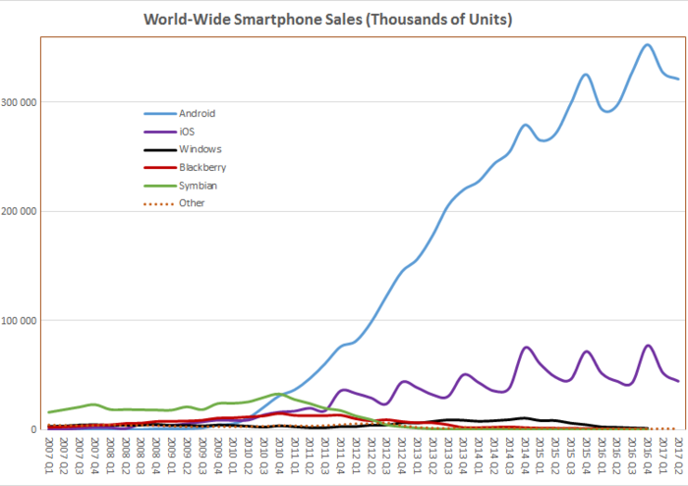
Sales comparison of os:-

Slide 9
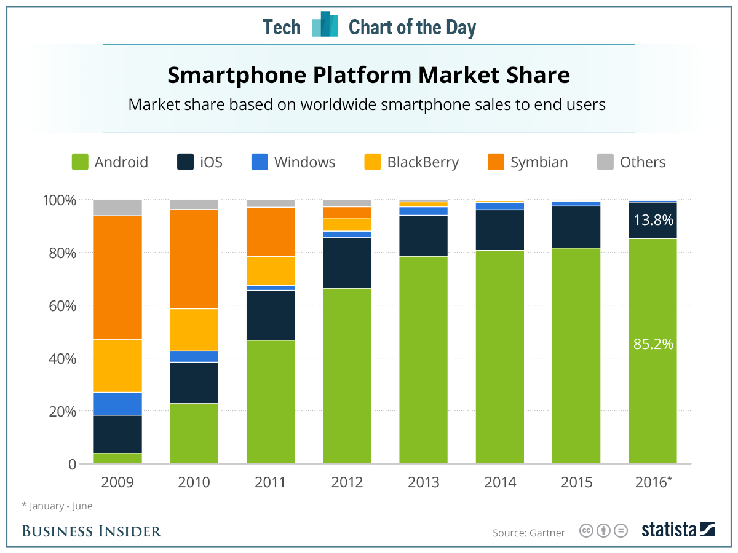
iOS vS Android Applications:-

Slide 10
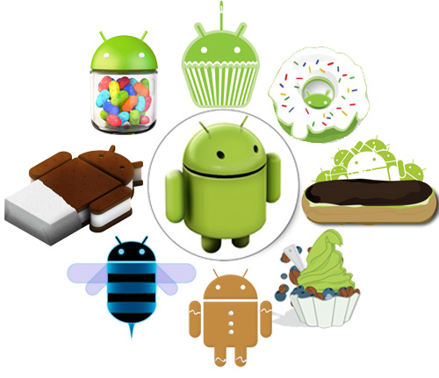
VERSIONS OF ANDROID
Android Beta
First Version of Android.
The focus of Android beta is testing incorporating usability.
Android beta will generally have many more problems on speed and performance.
Android Astro 1.0
First full version of android.
Released on September 23, 2008.
Wi-Fi and Bluetooth support.
Quite slow in operating.
copy and paste feature in the web browser is not present.

Slide 11

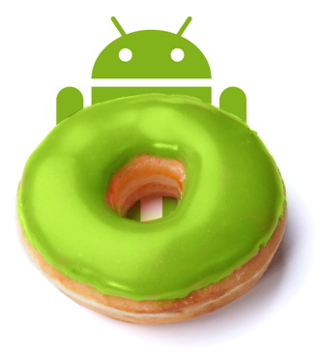
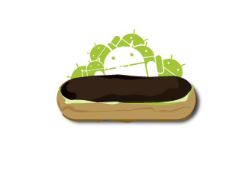
Android Cupcake 1.5
Released on April 30, 2009.
Added auto-rotation option.
Copy and Paste feature added in the web browser.
Increased speed and performance but not upto required level.
Android Donut 1.6
Released on September 15, 2009.
Voice search and Search box were added.
Faster OS boot times and fast web browsing experience.
Typing is quite slower.
Android Éclair 2.0/2.1
Released on October 26, 2009.
Bluetooth 2.1 support.
Improved typing speed on virtual keyboard, with smarter dictionary.
no Adobe flash media support.

Slide 12
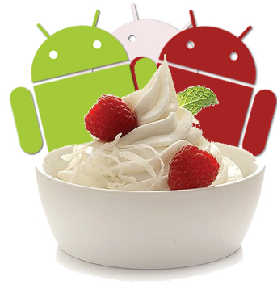


Android Froyo 2.2
Released on May 20, 2010.
Support for Adobe Flash 10.1
Improved Application launcher with better browser
No internet calling.
Android Gingerbread 2.3
Released on December 6, 2010.
Updated User Interface with high efficiency and speed
Internet calling
One touch word selection and copy/paste.
New keyboard for faster word input.
More successful version of Android than previous versions.
not supports multi-core processors.
Android Honeycomb 3.0
Released on February 22, 2011.
Support for multi-core processors
Ability to encrypt all user data.
This version of android is only available for tablets.

Slide 13
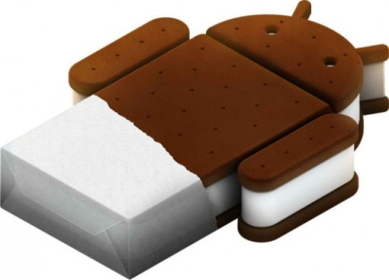

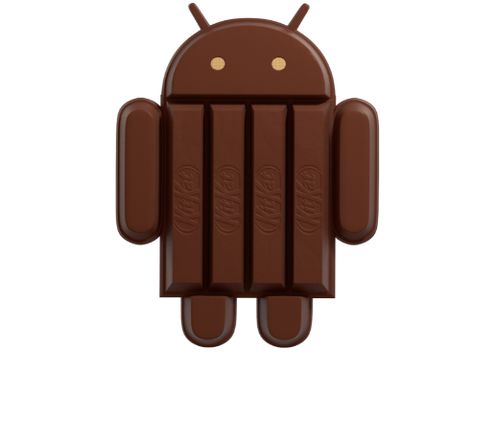
Android IceCreamSandwich(ICS) 4.0
Released on November 14, 2011.
Virtual button in the UI.
A new typeface family for the UI, Roboto.
Ability to shut down apps that are using data in the background.
Android JellyBean 4.1
Released on June 27, 2012.
Smoother user interface.
Expandable notifications.
Bi-directional text and other language.
Android KitKet 4.4
Released on October 31 , 2013.
Refreshed interface with white elements instead of blue.
Wi-Fi and mobile data activity (TX/RX) indicators are moved to quick settings.
Refreshed Dialer app interface.

Slide 14
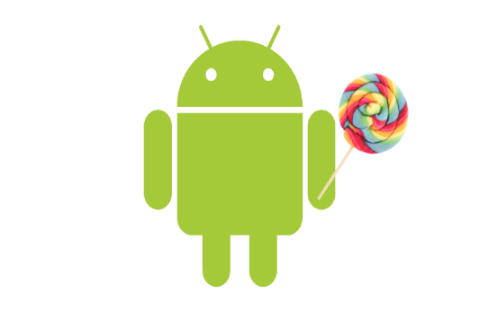
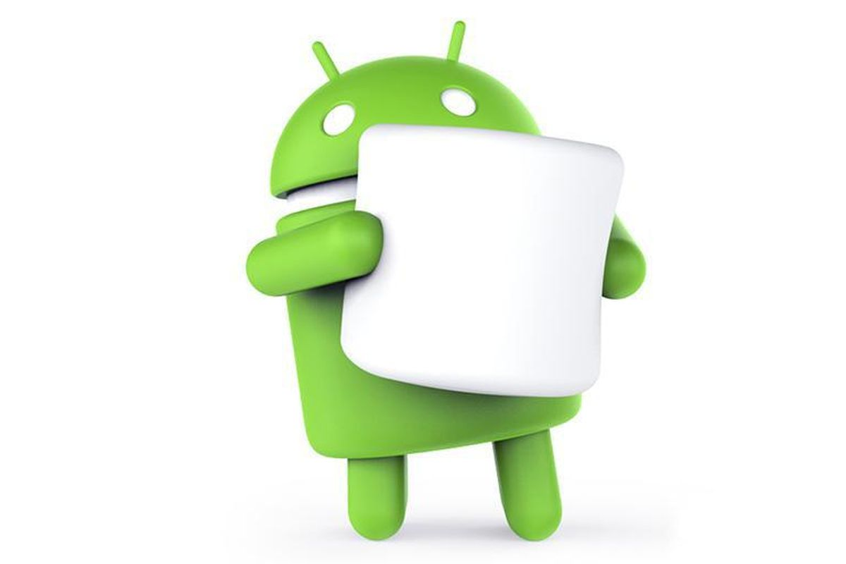
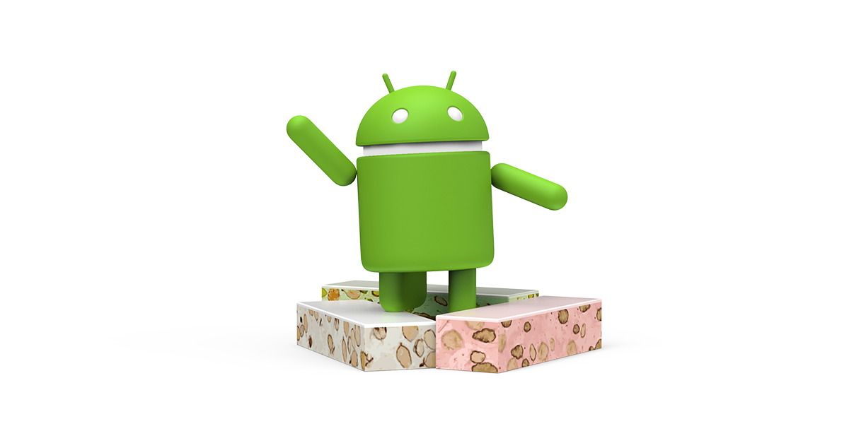
Android Lollipop 5.0
Released on June 25 , 2014.
Support for 64-bit CPUs.
Project Volta, for battery life improvements.
Guest logins and multiple user accounts are available on more devices, such as phones.
Android Marshmallow 6.0
Released on May 28 , 2015.
Native fingerprint reader support.
4K display mode for apps.
Automatic full data backup and restore for apps.
Android Nougat 7.0
Released on March 9 , 2016.
Ability to screen zoom.
Daydream virtual reality platform (VR interface).
Multi-window support, which supports floating apps on a desktop layout.

Slide 15
LIMITATIONS:-
Making source code available to everyone inevitably invites the attention of hackers.
Android operating system uses more amount of battery as compared to normal mobile phones.
As there are so many user sometimes it becomes difficult to connect all the users.
As we call Android is world of applications we continuously need to connected with the internet which is not possible for all the users.

Slide 16
CONCLUSION AND FUTURE SCOPE:-
Android is now stepping up in next level of mobile internet.
There are chances of Android Mobile sales becomes more then iPhone in next two years.
Google may launch another version of android that starts O because Google is launching all the android versions in the alphabetical order.
There are chances of Android may become the widely used operating system in world.

Slide 17
ANY QUESTIONS:-
PLEASE GO TO
WWW.GOOGLE.COM

